Slide 1

Memory Hierarchy in Computer Organization
Computer Organization and Architecture | Memory & I/O Organization
Computer Organization and Architecture | Memory & I/O Organization | Bachelor of Engineering
DISCOVER · LEARN · EMPOWER
Notes:
Welcome everyone to today's lecture on Computer Organization and Architecture. We are focusing on the critical topic of Memory hierarchy within the broader context of Memory and I/O Organization. As Chandigarh University students, you are here to Discover, Learn, and Empower yourselves with these fundamental engineering concepts. Let us begin by understanding why memory hierarchy is the backbone of modern computing performance.

Slide 2
Course Outcomes
SLIDE 2 / 10
Course Outcome
CO | BT LEVEL | DESCRIPTION
CO1 | BT3 | Apply number systems and digital logic to design basic digital circuits
CO2 | BT4 | Analyze register organization and instruction set architecture
CO3 | BT3 | Implement computer arithmetic algorithms and floating-point operations
CO4 | BT5 | Analyze memory hierarchy and input-output organization
CO5 | BT6 | Evaluate control unit design and pipelining performance
Chandigarh University
2 / 10
Notes:
Today's lecture is directly mapped to Course Outcome 4, which requires you to analyze memory hierarchy and input-output organization. This means you must not just memorize definitions but critically evaluate how different memory levels interact. By the end of this session, you will be able to deconstruct the trade-offs between speed, cost, and capacity in system design. This analytical skill is essential for your engineering career.

Slide 3
Learning Objectives
SLIDE 3 / 10
Learning Outcomes
1
Evaluate the necessity of memory hierarchy to bridge processor and main memory speed gaps.
2
Analyze the trade-offs between access time, cost per bit, and capacity across levels.
3
Examine the principle of locality as the fundamental justification for hierarchical storage structures.
4
Assess the impact of cache hit ratios on the overall effective access time of a system.
5
Construct a comparative model of SRAM, DRAM, and magnetic disk characteristics.
Chandigarh University
3 / 10
Notes:
By the end of this lecture, you will be able to evaluate why we need a hierarchy instead of one giant memory. You will analyze the classic trade-off where faster memory is more expensive and smaller. We will examine how the principle of locality justifies keeping frequently used data close to the processor. Finally, you will assess how cache hit ratios directly influence the speed of your entire computer system.

Slide 4
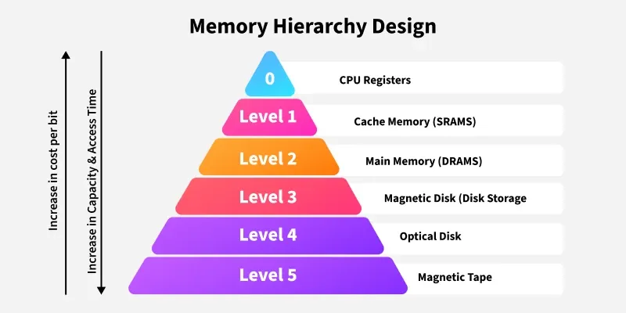
Lecture
SLIDE 4 / 10
Definition of Memory Hierarchy
1
Memory hierarchy organizes storage devices into levels based on speed, cost, and capacity.
2
The top level consists of registers and cache, offering the fastest access ×.
3
The bottom level includes magnetic disks and tapes, providing the largest storage capacity.
4
Each level acts as a buffer for the next slower level to improve performance.
5
The structure ensures the processor sees an average access time close to the fastest level.
Memory Hierarchy Design and its Characteristics - GeeksforGeeks
Chandigarh University
4 / 10
Notes:
Think of memory hierarchy as a pyramid where the top is small but incredibly fast, and the base is massive but slow. The top level contains registers and cache, which are the fastest but most expensive. The bottom level includes magnetic disks and tapes, which are slow but offer gigabytes of storage. This structure ensures that the processor effectively sees an average access time close to the fastest level, masking the slowness of the disk.

Slide 5
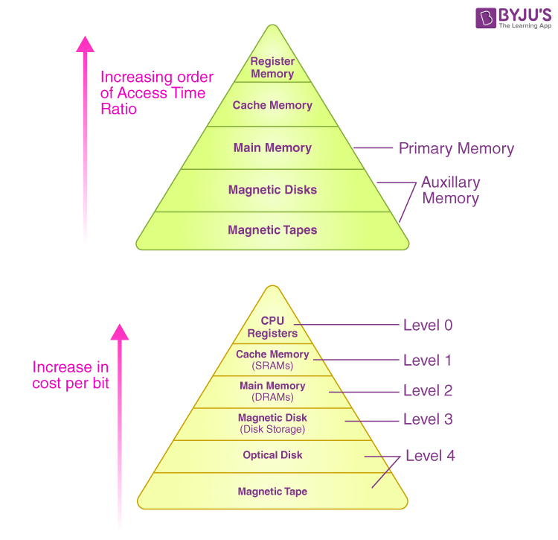
Lecture
SLIDE 5 / 10
Principle of Locality
1
Temporal locality implies recently accessed data is likely to be accessed again soon.
2
Spatial locality implies data near recently accessed addresses is likely to be needed next.
3
These principles justify keeping a small subset of data in faster, smaller memory.
4
Without locality, the effectiveness of cache memory would be negligible for performance.
5
Programs naturally exhibit these patterns, allowing efficient data prediction and prefetching.
Design and Characteristics of Memory Hierarchy (source: cdn1.byjus.com)
Chandigarh University
5 / 10
Notes:
The entire concept of memory hierarchy relies on the principle of locality. Temporal locality means if you use a variable now, you will likely use it again soon, like a loop counter. Spatial locality means if you access an array element, you will likely access the next one. Without these patterns, our caches would be useless because we could not predict what data to keep. This natural behavior of programs allows us to keep a small fast memory working efficiently.

Slide 6
Lecture
SLIDE 6 / 10
Performance Metrics and Trade-offs
1
Access time decreases and cost per bit increases as we move up the hierarchy.
2
Capacity increases significantly as we move down the hierarchy to the slower levels.
3
The goal is to maximize the hit ratio to minimize the average access time.
4
Effective access time is a weighted average of cache hits and main memory misses.
5
Designers must balance the cost of adding cache against the performance gains achieved.
Memory Hierarchy Design and its Characteristics - GeeksforGeeks (source: media.geeksforgeeks.org)
Chandigarh University
6 / 10
Notes:
As we move up the hierarchy, access time decreases while the cost per bit increases dramatically. Conversely, capacity increases significantly as we go down to slower, cheaper storage. The primary design goal is to maximize the hit ratio, which is the percentage of requests found in the fast memory. Effective access time is calculated as a weighted average of these hits and misses. Engineers must carefully balance the cost of adding more cache against the performance gains it provides.

Slide 7
Lecture
SLIDE 7 / 10
Cache Memory Mapping Techniques
1
Direct mapping assigns each block of main memory to exactly one cache line.
2
Associative mapping allows a block to be placed in any cache line available.
3
Set-associative mapping divides cache into sets where a block maps to a specific set.
4
Direct mapping is simple but suffers from high conflict misses in certain patterns.
5
Associative mapping offers flexibility but requires complex hardware for tag comparison.
Chandigarh University
7 / 10
Notes:
There are three main ways to map data from main memory into the cache. Direct mapping is the simplest, assigning each block to exactly one specific line, but it can cause conflicts. Associative mapping is the most flexible, allowing a block to go anywhere, but it requires complex hardware to search all lines. Set-associative mapping strikes a balance by dividing the cache into sets where a block can go to any line within that set. This technique reduces conflict misses while keeping hardware complexity manageable.

Slide 8
Lecture
SLIDE 8 / 10
Effective Access Time Calculation
GOVERNING EQUATION
Effective access time = (Hit ratio × Cache time) + (Miss ratio × Main memory time)
1
Miss penalty is the additional time required to fetch data from the slower level.
2
A hit ratio of 0.95 means 95% of requests are satisfied by the fast cache.
3
Improving hit ratio has a greater impact on performance than reducing cache access time.
4
The formula assumes the processor waits for the slower memory only on a miss.
Design and Characteristics of Memory Hierarchy (source: cdn1.byjus.com)
Chandigarh University
8 / 10
Notes:
Let's look at the formula for effective access time. It is the hit ratio × the cache time plus the miss ratio × the main memory time. If your hit ratio is 0.95, it means 95% of requests are satisfied by the fast cache. Improving this hit ratio has a much greater impact on performance than simply making the cache slightly faster. The formula assumes the processor waits for the slower memory only when a miss occurs, incurring the full penalty.

Slide 9

Lecture
SLIDE 9 / 10
Key Takeaways
1
Memory hierarchy balances speed, cost, and capacity to optimize system performance.
2
Locality of reference is the fundamental reason why caching works effectively.
3
Cache hit ratio is the most critical metric for determining overall system speed.
4
Mapping techniques like direct and set-associative manage data placement in cache.
5
Effective access time is a weighted average that reflects the hierarchy's efficiency.
Source: www.slideteam.net
Chandigarh University
9 / 10
Notes:
To summarize, memory hierarchy is essential for balancing speed, cost, and capacity in modern computers. The principle of locality is the fundamental reason why caching works so effectively for our programs. The cache hit ratio is the most critical metric we must optimize to determine overall system speed. Remember that mapping techniques manage how data is placed, and effective access time reflects the overall efficiency of this entire structure.

Slide 10
Lecture
SLIDE 10 / 10
References
COMPUTER ORGANIZATION AND DESIGN
The Hardware/Software Interface — David A. Patterson, John L. Hennessy
COMPUTER ARCHITECTURE
A Quantitative Approach — John L. Hennessy, David A. Patterson
• Computer Organization and Architecture — William Stallings
• Computer System Architecture — M. Morris Mano & Rajib Mall
• Computer Organization — Carl Hamacher, Zvonko Vranesic, Safwat Zaky
Chandigarh University
10 / 10
Notes:
For further reading and deeper understanding of these concepts, please refer to the standard textbooks listed here. William Stallings and M. Morris Mano provide excellent foundational theories on computer organization. Carl Hamacher and the works by Patterson and Hennessy offer quantitative approaches and modern design perspectives. I encourage you to consult these references to master the analysis of memory hierarchy for your exams and projects.

